Slide 1

Salary Prediction using Linear Regression
Capstone Interim Presentation
By Group II

Slide 2
About
Every year more than a million engineers enter the workforce worldwide. One question that arises is what regulates the jobs and their respective starting salaries right after graduation.
Preceding studies have presented/demonstrated the influence of distinct elements such as academic grades, college notoriety, the area of study and specialization, the demand for such specialization and so on.
But the one thing that such analysis is missing is that it does not take into consideration a standardized measure of job skills performed at the time of completion of studies.

Slide 3
Data Description
Aspiring Minds Employability Outcomes provides engineering graduates employment outcomes along with salaries, job locations and job titles with standardized assessment scores in three principal fields - personality, cognitive skills and technical skills.
Together with biodata summary, AMEO 2015 provides an evaluation for a unique and holistic overview of the entry level labor market.
This data can be used to make a meticulous salary prediction and can also be used to perceive as to what impacts job titles and salary in the labor market.
DIMENSIONS: 3998 Instances and 35 Features.

Slide 4
Problem Statement
The purpose of this project is to predict employability of the graduate engineers and to propose an implementation of sector specific job readiness tests for job seekers that assess their employability.
This analysis tries to supply answers to the subsequent questions:
to predict employability of the graduate engineers
to propose an implementation of sector specific job readiness tests for job seekers that assess their employability.

Slide 5

Preprocessing
Of
Data

Slide 6

Following Steps were taken for data cleaning and Preprocessing:
Replaced invalid values of marks with 0, as the student was not present, or the subject was not of his/her interest.
There were no missing/null values in the data.
Only analyzed the outliers, as on removing
them there would have been a severe data
loss.
Cleaned and binned the 10th Board , 12th Board and specialization columns where it has more than 200 classes in each column.
Feature engineering:
Extracted the - Age column using graduation
year and D.O.B.
Gap in Education using Year difference & degree column.

Slide 7

Exploratory Data Analysis
(EDA)

Slide 8
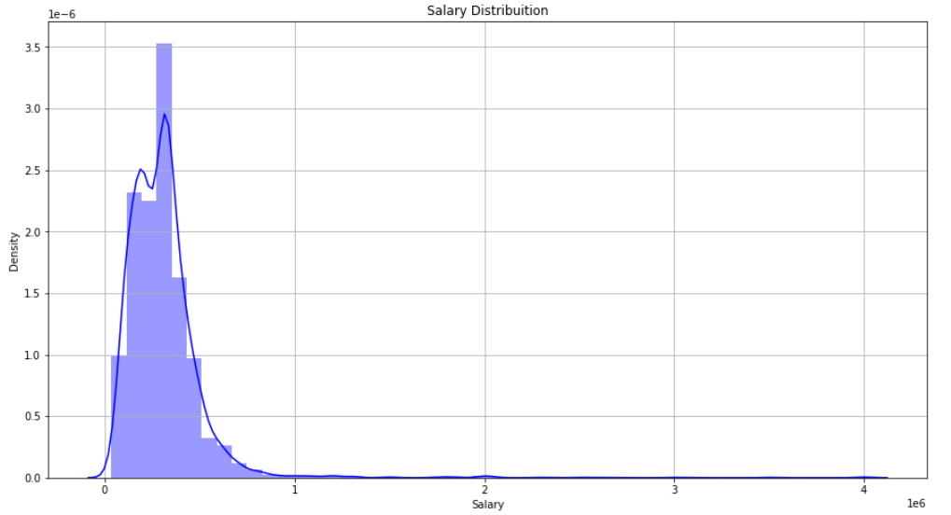

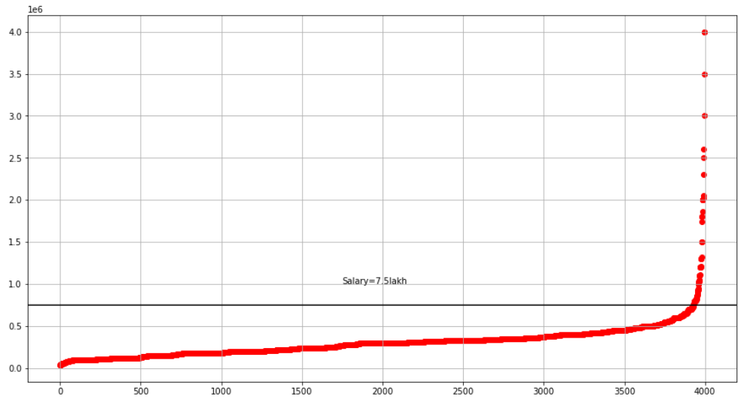
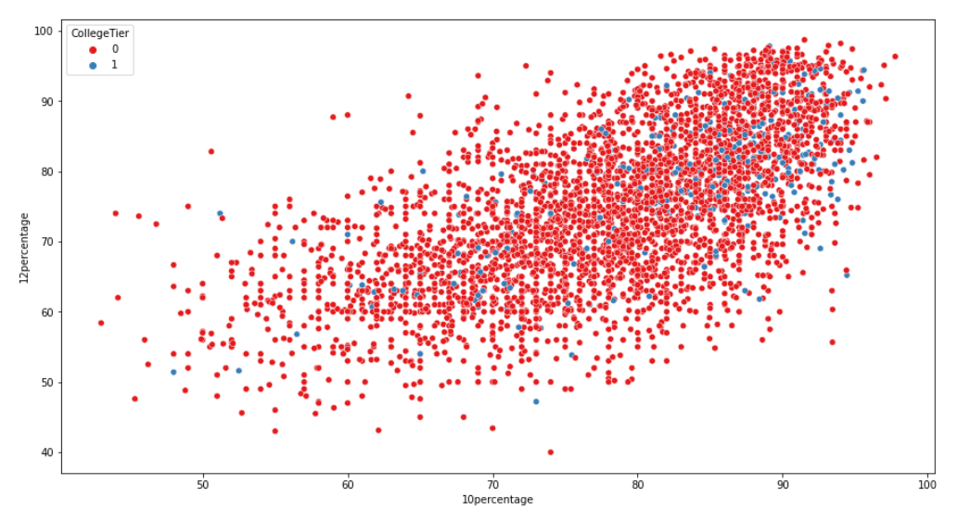
We Conclude the following based on our observations:
The Target: salary column is highly right skewed. As we had not removed the outliers in the data, so we have used transformation techniques for the model building.
Most of the students are having salary less than 7.5 L.P.A whereas the highest salary of the students is 40 L.P.A.
The concentration of the blue cluster is at the top right corner, so we inferred that the students who scored more in 10th and 12th boards got the Premium Tier 1 colleges in their Graduation.

Slide 9
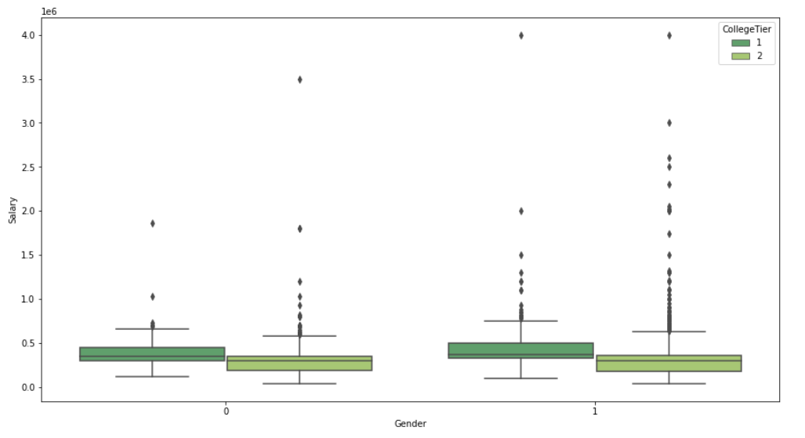
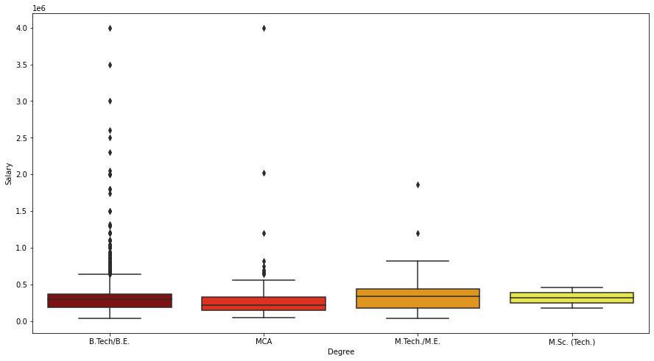
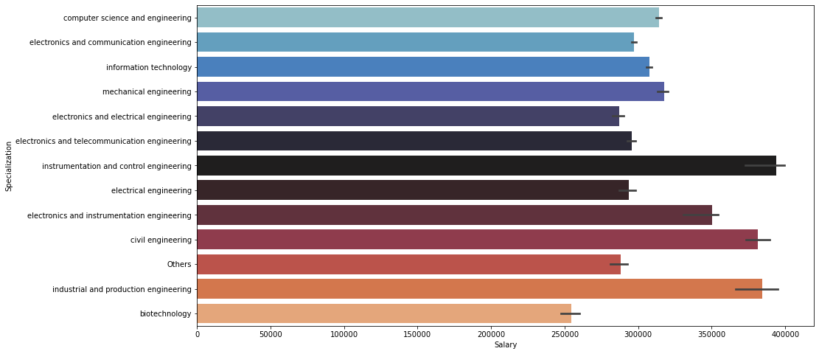
Based on college tier both males and females who graduated from a Tier1 college has got higher salary as compared to the middle facilities colleges.
The salary makers from both tier colleges had better pay than those who did MTech in their post graduation but the highest salary makers among all the students were those who did BTech in their graduation.
The highest average salary makers were from the Instrumentation and Control Engineering followed by Industrial and Production Engineering, whereas the lowest average salary makers were from the Biotechnology background.

Slide 10
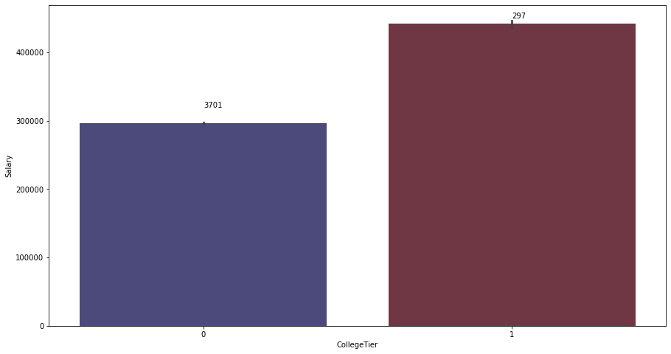
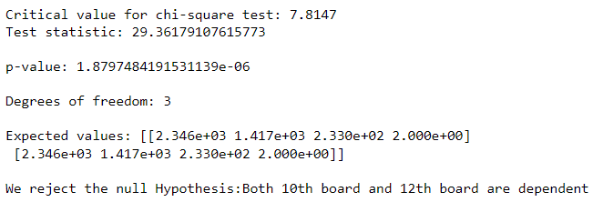
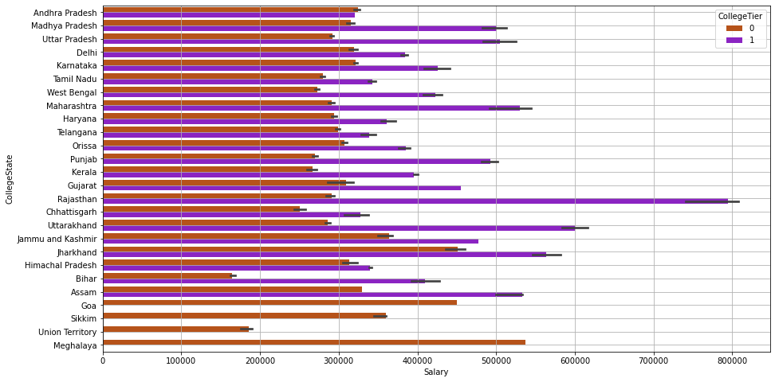
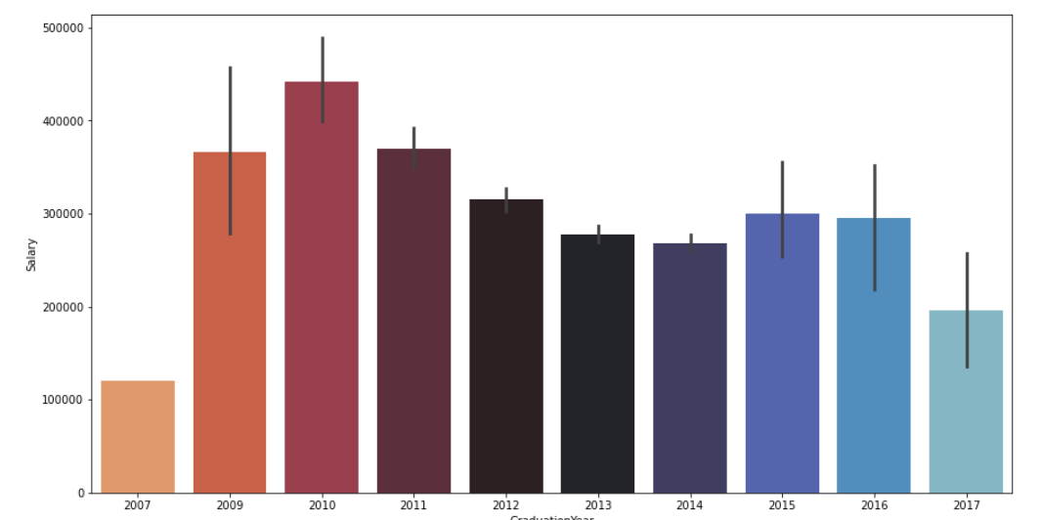
infer
We performed Chi-square statistical test and found the dependency of 10th board and 12th board column.
The average salary of the students having college tier 1 is high as compared to others in all the degrees.
In all the states the average salary of students belonging to college tier 1 was higher compared to the tier 0 college students and few states didn’t have tier 1 colleges.
The average salary of the students graduated in year 2010, 2011 and 2009 was highest, thus we conclude that they had some experience.

Slide 11

Algorithm

Slide 12
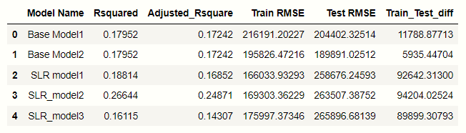
We removed all the Insignificant Features from the data based on Business Understanding and the statistical tests performed earlier and moved to the model building part.
To build the model we use the following approach:
Initially we build an OLS base model by using the average of target column which gave us Adj_R2 as 0.17242, we further worked on various technique to improve our Adj_R2 value to give better prediction.
Though the data contains many outliers (highly skewed), we are restrained to not remove the records, we transformed the highly skewed columns to overcome the issue of outliers then we build the OLS model again.

Slide 13
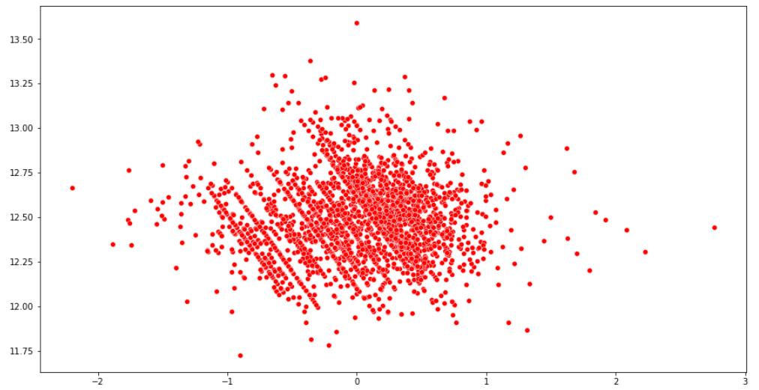

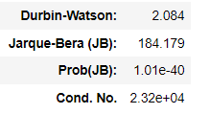
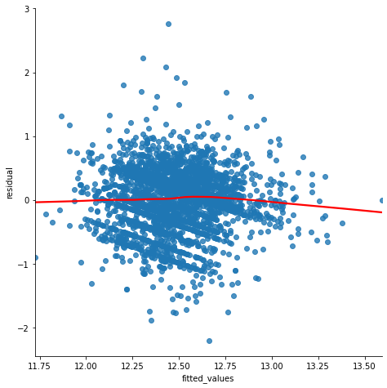
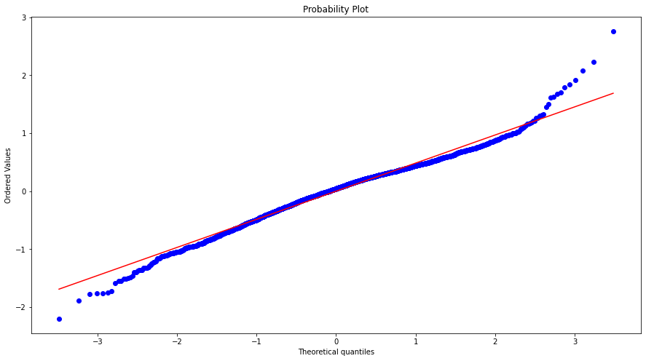

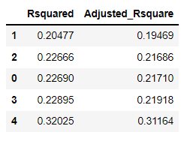
We check all the assumptions of Linear Regression that is applied before and after the model building.
After checking all the assumptions of Linear Regression, we applied sequential feature selector and build a Linear Regression model using cross validation with the best features and got the accuracy with 31% Adj_R2.
Linearity of Data - Residuals v/s Fitted Plot
As the assumptions of Linear Regression were not met up to the mark, so we moved to build AI based models.
Heteroskedasticity
Model using SFS and CV
Normality Plot

Slide 14
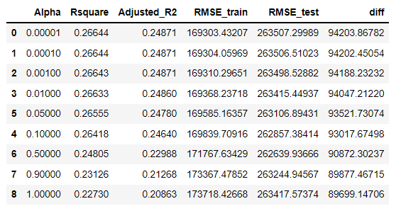
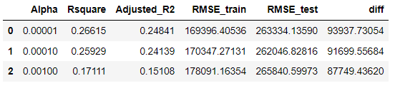
We built Lasso and Ridge Regression model by decreasing the shrinkage parameter (increasing the bias) at different alpha values, to get a more generalized model.
We had built a decision tree, Random forest model (with and without hyperparameter tuning) as they are not influenced by outliers.
To reduce bias and variance in the model we used boosting techniques such as Gradient boosting and XG boosting.
Since the data has many features, so to overcome the curse of dimensionality, we used PCA to reduce multi collinearity in the data and then built a Decision Tree model on it.
Ridge Regression at different alpha values
Lasso Regression at different alpha values

Slide 15
Conclusions and Proposed Solutions

Slide 16
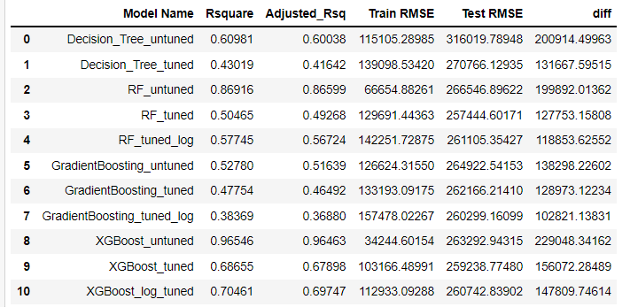
Model Solutions
AI Based Models with Hyper Parameter Tuning
We got the best accuracy and least RMSE from Random Forest ( 56% Adj_R2) , Gradient Boost (36 %Adj_R2) and XG Boost (69% Aj_R2_) on Transformed Target column after Hyperparameter tuning.
The Data didn’t have Linear Features, so Linear Regression model was unable to capture the trend of the overall data & it was unable to reach to the Global minima in terms of Cost function which was clearly reflected as the assumptions didn’t meet up.
Whereas it was achievable by the AI based algorithms to get a more Generalized model with low bias and low variance to much better extent as compared to Linear Regression.
Business Solutions
Not all the states having Premium colleges had the effect on Salary distribution. So building more premium colleges in those states as well as within the country is a solution to meet the demand of employability as lakhs of engineers get graduated every year.

Slide 17
Mentor
Ankush Bansal
Team Members
Anurup Dey Kirty
Gunjan Sansanwal
Nitika Arora
Piyush Malik
Uma Khanna
Vikas Chauhan

Slide 18
Thank you!

